Slide 1
CQRS and Event Sourcing Author : Srinivas B
CONFIDENTIAL | © 2021 EPAM Systems, Inc.

Slide 2
CQRS(Command Query Responsibility Segregation)
CQRS is a software design that stands for Command Query Responsibility Segregation
CQRS suggests that application should be divided in a command and a query services. Commands alters the state of an object or entity and query return the state of an object or entity
Instead of having a single interface for read and write operations CQRS alters the state and queries the data as 2 separate concerns.
Why CQRS
CQRS allows us to scale up the command and query sides independently.
Also, for applications which are being used by many users or need to support a lot of parallel operations on the same set of data

Slide 3
Event Sourcing
Event Sourcing defines an approach where all the changes that are made to an object or entity are stored as immutable events to event store, as opposed to storing just the current state. It has tremendous benefits for auditability.
Why Event Sourcing must be combined with CQRS
What will happen if the query API fails and unable to fetch the info from database. Due to some reasons, records are lost. How the database will be recovered or repopulated with all the old data or records.
This is the reason we must combine CQRS & Event Sourcing so even if we lost the data, the events will be safe in the event store which will be repopulating the records from Event store back to the Database. This makes CQRS and Event Sourcing as Atomic.
How do we maintain event store and maintaining it also difficult these days
The solution is Axon Framework – provides Zero configuration event store.

Slide 4
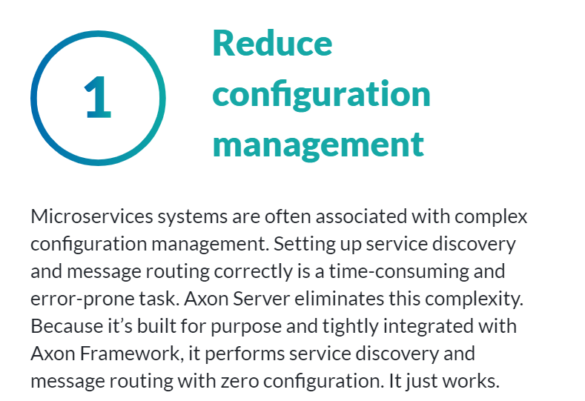
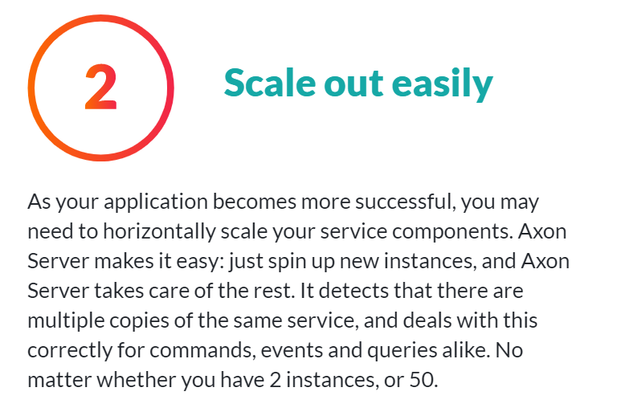
Why Axon Server

Slide 5
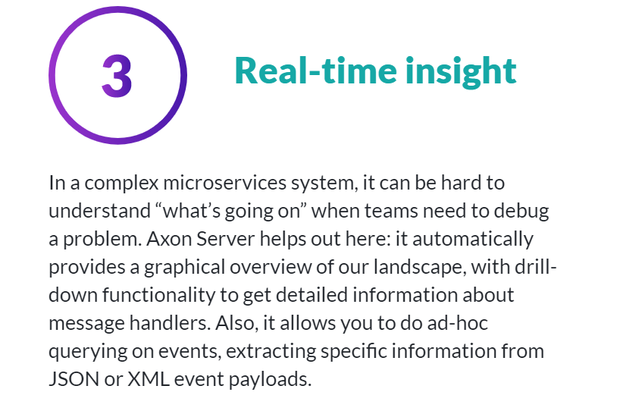
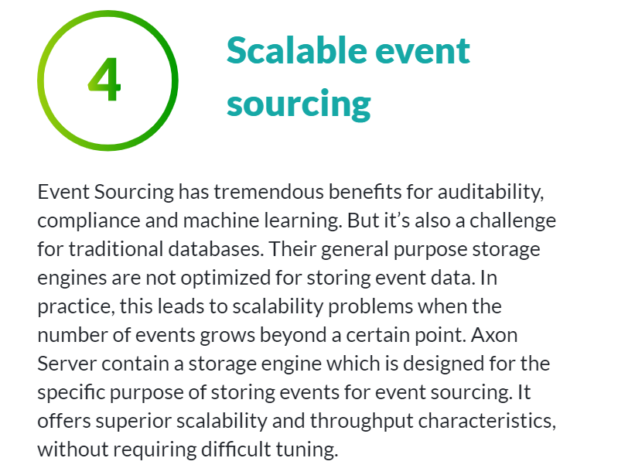
Why Axon Server

Slide 6
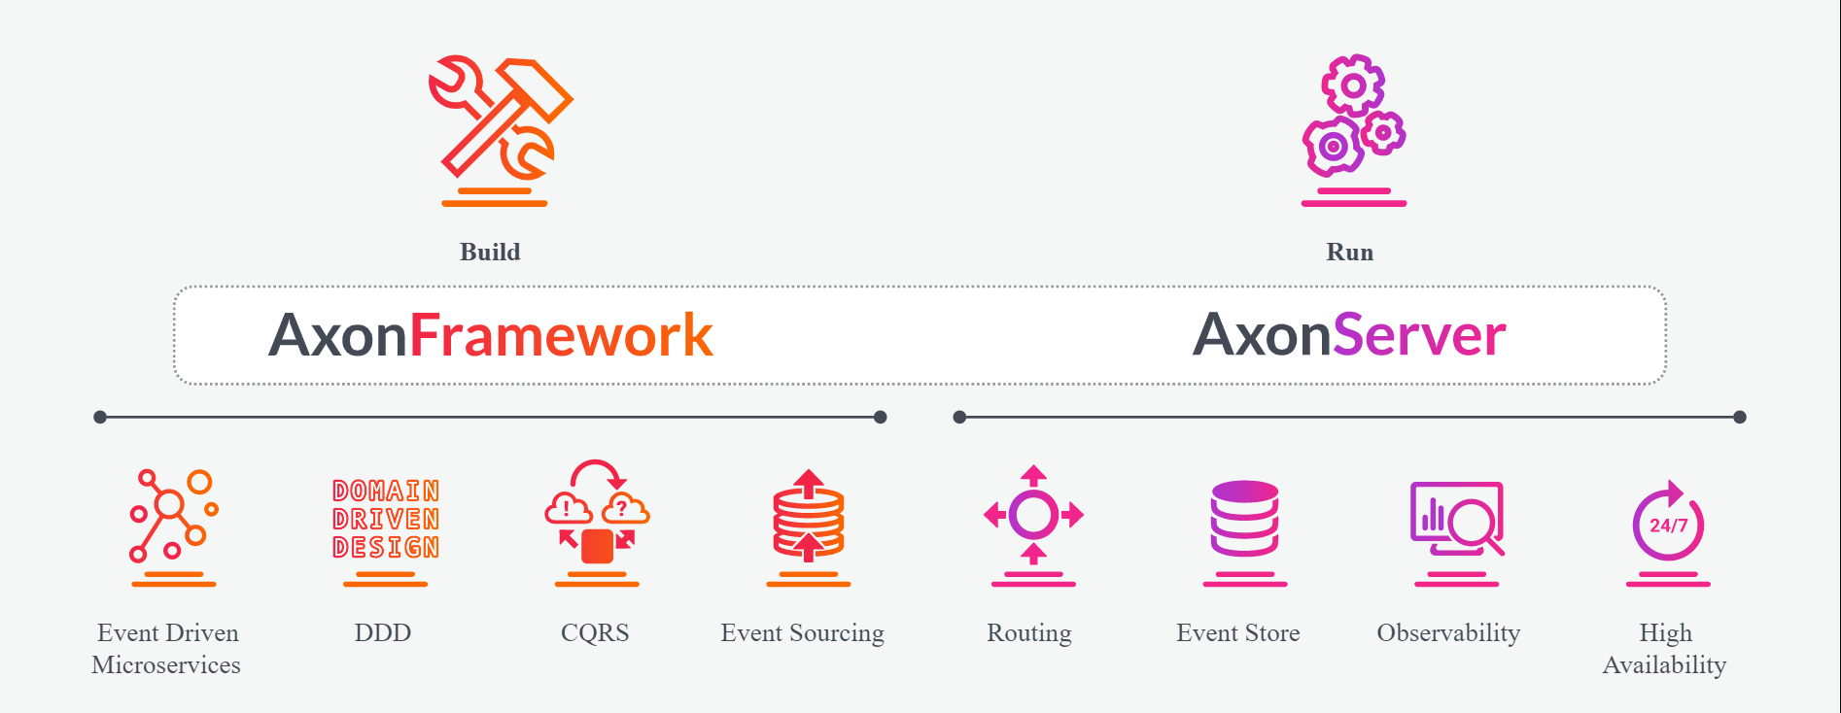
Axon Framework and Axon Server

Slide 7
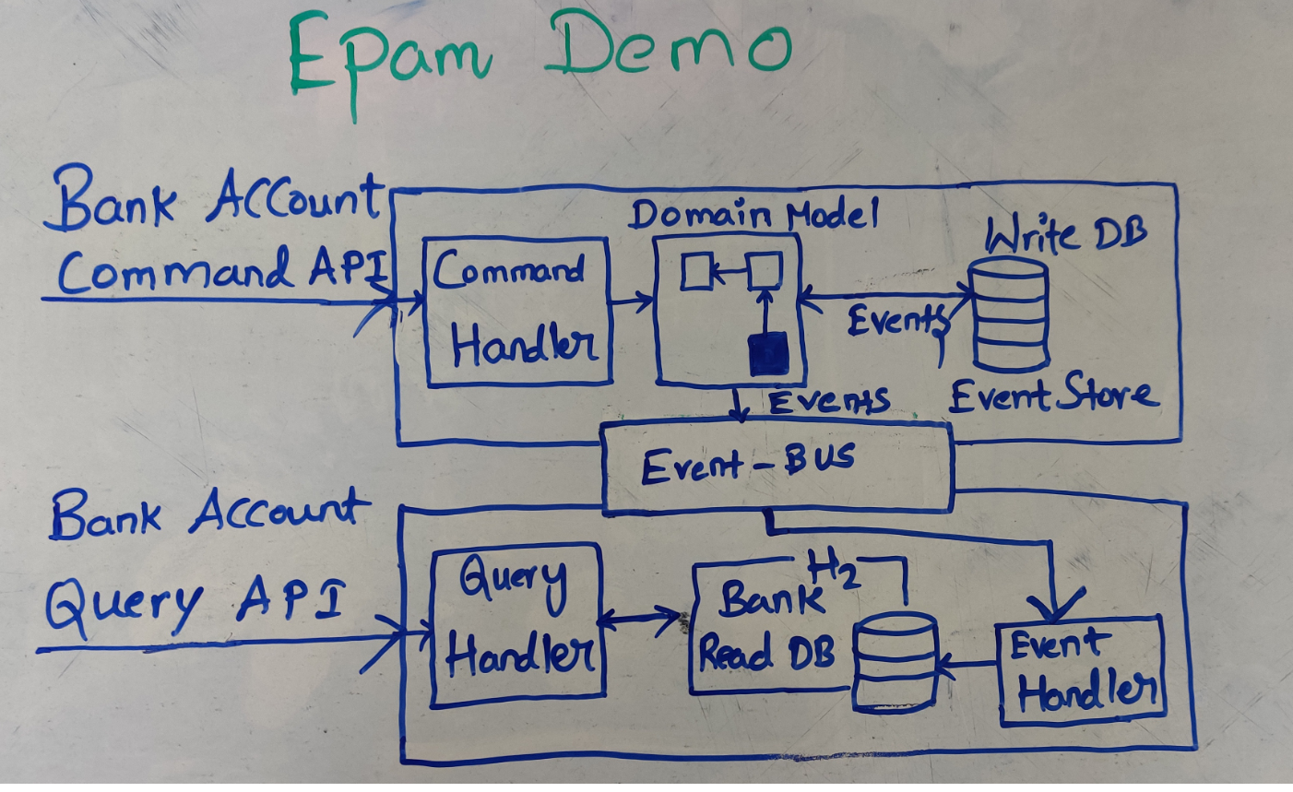
Application Overview

Slide 8
Any Questions?

Slide 9
Thank You

